Slide 1
Project_Lab_1:
16-bit ALU On FPGA Board

Slide 2
What is an ALU and How It Works?
Definition: An Arithmetic Logic Unit (ALU) is a critical component of a processor that performs arithmetic and logical operations.
Functions:
Arithmetic operations: Addition, subtraction, multiplication, and division.
Logical operations: AND, OR, NOT, XOR, etc.
Structure:
Inputs: Operands (data) and control signals.
Output: Result of the operation and status flags (e.g., zero, carry, overflow).
Working: The ALU receives instructions from the control unit, executes the operations as per the control signals, and sends results to registers or memory.

Slide 3
What is an FPGA?
Definition: Field Programmable Gate Arrays (FPGAs) are reconfigurable integrated circuits that can be programmed to implement any digital logic function.
Features:
Composed of configurable logic blocks (CLBs), routing fabric, and input/output blocks.
Allows parallel execution of tasks.
High-speed performance and flexibility in design.
Applications:
Digital signal processing (DSP).
Embedded systems, telecommunications, and custom hardware accelerators.

Slide 4
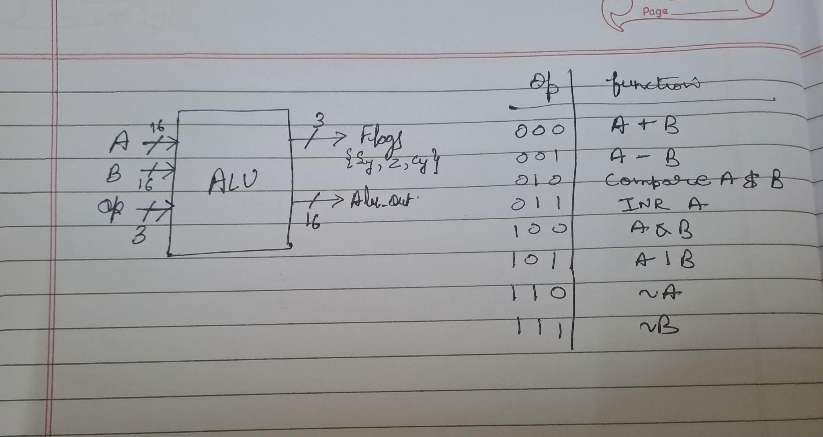
Step 1 - Designing the ALU

Slide 5
Step 2 - Write Verilog Code
module alu_sub(
input [15:0] A, B,
input [2:0] op,
output wire [15:0] Alu_out,
output wire [2:0] flags // [2] = Sign, [1] = Zero, [0] = Carry
);
reg [16:0] temp; // Temporary register
always @(*) begin
flags = 3'b000;
Alu_out = 16'h0000;
case (op)
3'b000: begin // Addition
temp = {1'b0, A} + {1'b0, B};
Alu_out = temp[15:0];
flags[0] = temp[16];
flags[2] = Alu_out[15];
flags[1] = (Alu_out == 16'h0000) ? 1'b1 : 1'b0;
end
3'b001: begin // Subtraction
temp = {1'b0, A} - {1'b0, B};
Alu_out = temp[15:0];
flags[0] = temp[16];
flags[2] = Alu_out[15];
flags[1] = (Alu_out == 16'h0000) ? 1'b1 : 1'b0;
end
3'b010: begin // Compare A and B
temp = {1'b0, A} - {1'b0, B};
Alu_out =16'h0000;
flags[0] = temp[16];
flags[2] = Alu_out[15];
flags[1] = (Alu_out == 16'h0000) ? 1'b1 : 1'b0;
end
3'b011: begin // Increment A
temp = {1'b0, A} + 1;
Alu_out = temp[15:0];
flags[0] = temp[16];
flags[2] = Alu_out[15];
flags[1] = (Alu_out == 16'h0000) ? 1'b1 : 1'b0;
end
3'b100: begin // Bitwise AND
Alu_out = A & B;
flags[2] = Alu_out[15];
flags[1] = (Alu_out == 16'h0000) ? 1'b1 : 1'b0;
end
3'b101: begin // Bitwise OR
Alu_out = A | B;
flags[2] = Alu_out[15];
flags[1] = (Alu_out == 16'h0000) ? 1'b1 : 1'b0;
end
3'b110: begin // Bitwise NOT A
Alu_out = ~A;
flags[2] = Alu_out[15];
flags[1] = (Alu_out == 16'h0000) ? 1'b1 : 1'b0;
end
3'b111: begin // Bitwise NOT B
Alu_out = ~B;
flags[2] = Alu_out[15];
flags[1] = (Alu_out == 16'h0000) ? 1'b1 : 1'b0;
end
default: begin
Alu_out = 16'h0000;
flags = 3'b000;
end
endcase
end
endmodule

Slide 6
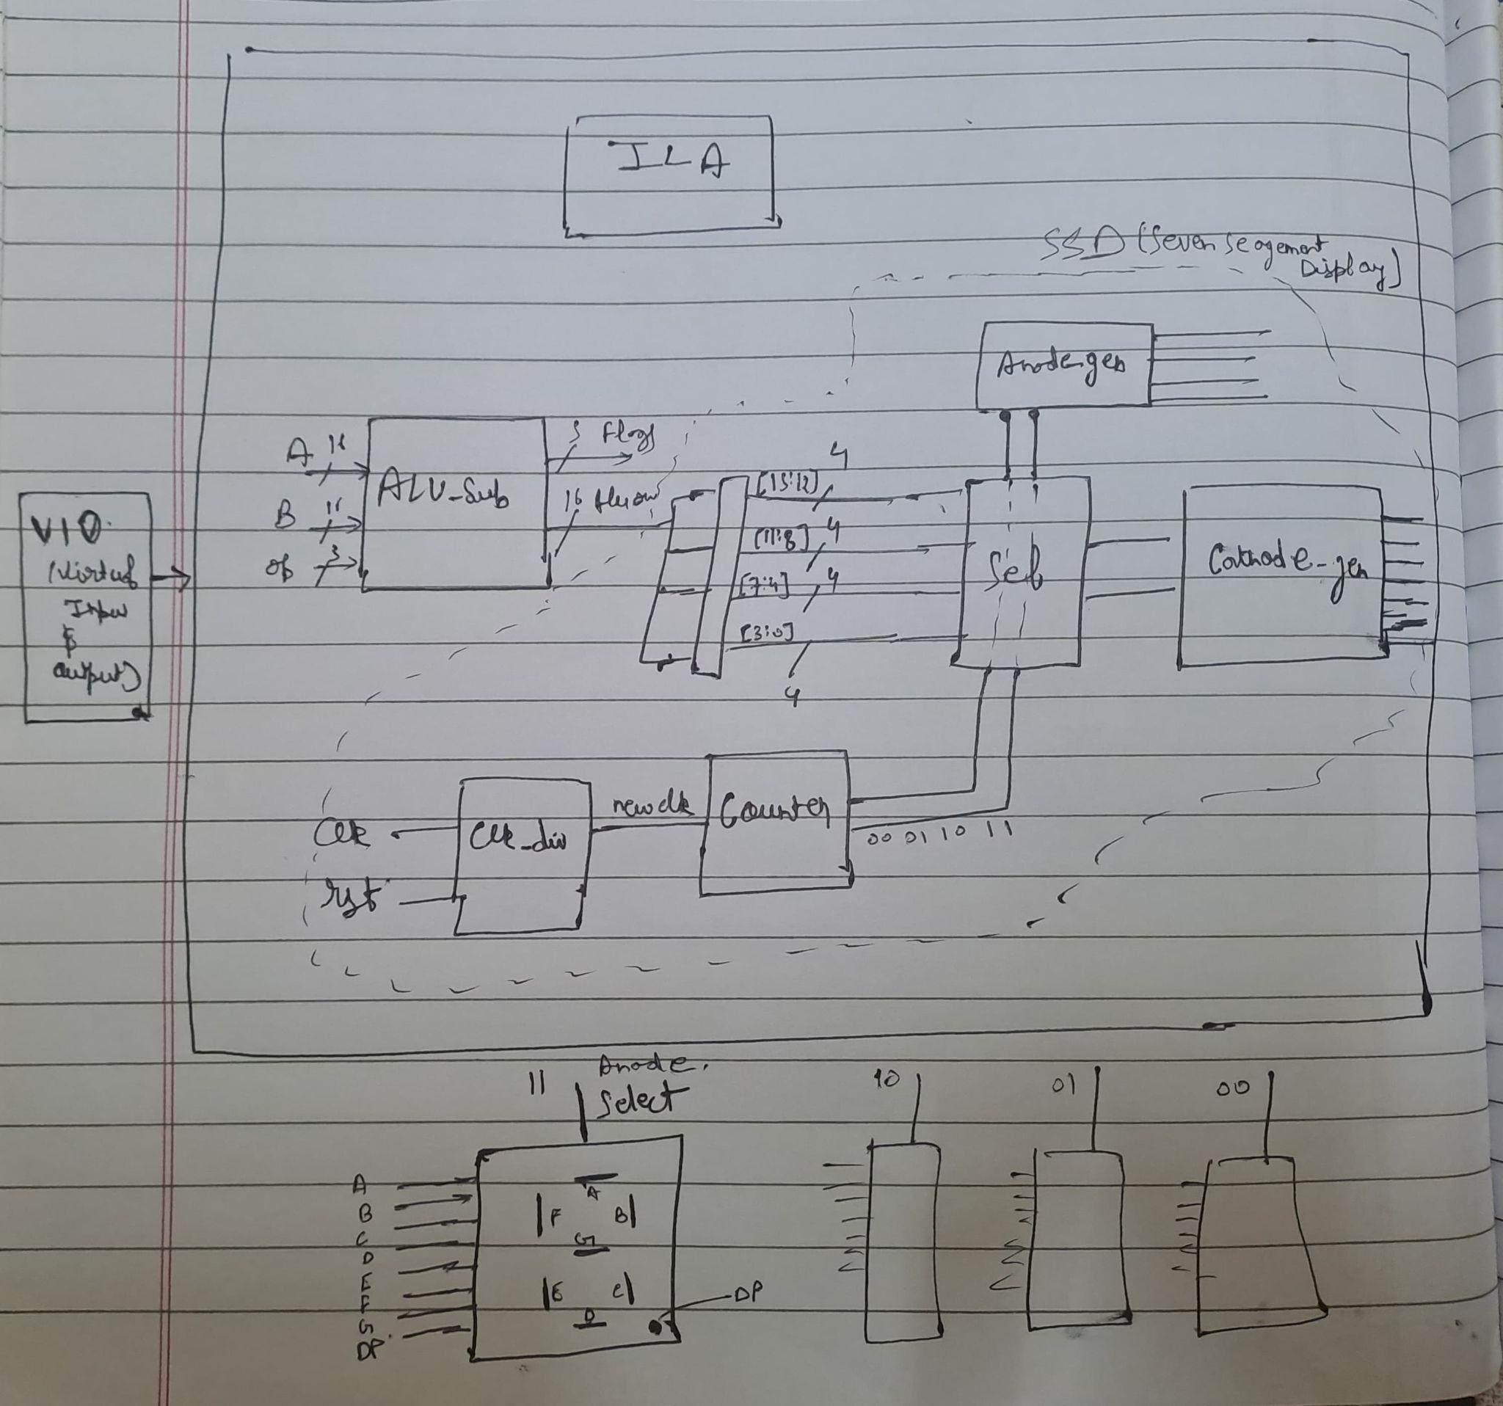
Step 3 - Implement it on FPGA

Slide 7

Thanks!
Tanmay Maheshwari 2022UEC1616

